Slide 1
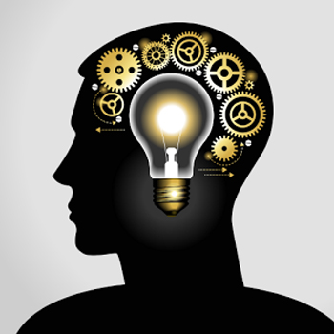
Critical Thinking Skills: An introduction
II year, B. E. Computer Science and Engineering - RUSA
S1E1: August 17, 2020
Dr. A. R. S. Jayanth
Department of English
MIT Campus
Anna University

Slide 2

First things first
A quick overview
Course - XXI Century Skills
Collaboration and teamwork
Creativity and imagination
Critical thinking
Problem solving

Slide 3
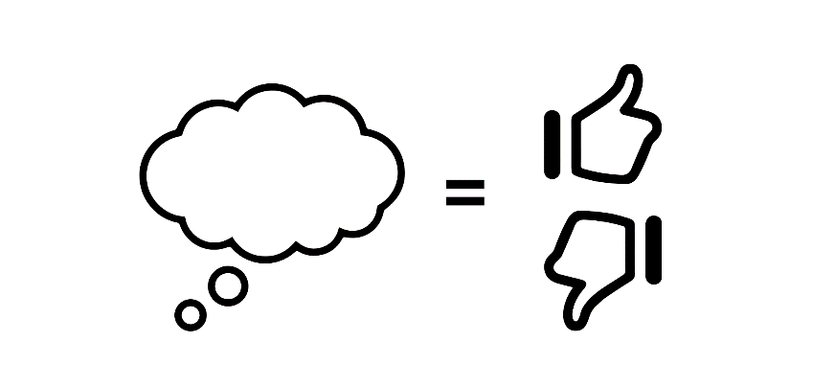
Critical Thinking Skills – WHY???
TO MAKE SENSE

Slide 4
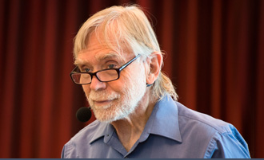
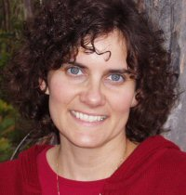
Definition of CT
A process by which the thinkers improve the quality of thinking by skillfully taking charge of the structures inherent in thinking and imposing intellectual standards upon them.
Paul and Elder (2001)
Richard Paul
Founder
The Foundation for Critical Thinking
Dr. Linda Elder
President and Executive Director
The Foundation for Critical Thinking

Slide 5
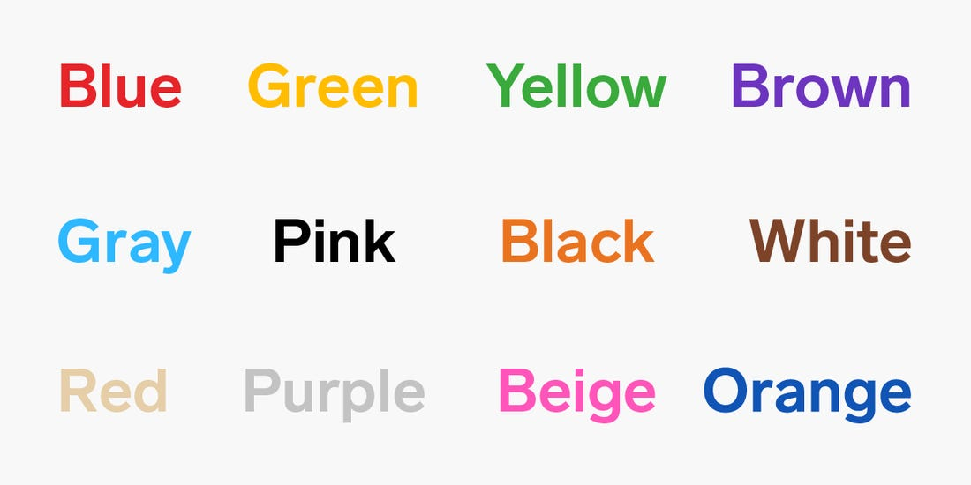
Look at the words and say the COLORS
Source: www.insider.com

Slide 6

Are the lines made out of the blue squares parallel?
Source: www.ultimatepuzzle.com

Slide 7
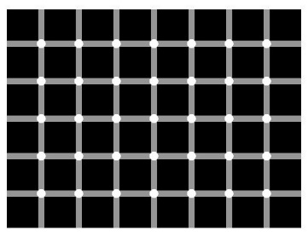
Can you count the black dots?
Source: www.ultimatepuzzle.com

Slide 8

Thinking
It’s a natural process
Biased
Distorted
Partial
Prejudiced

Slide 9
Critical Thinking
An ability to analyze and evaluate information

Slide 10
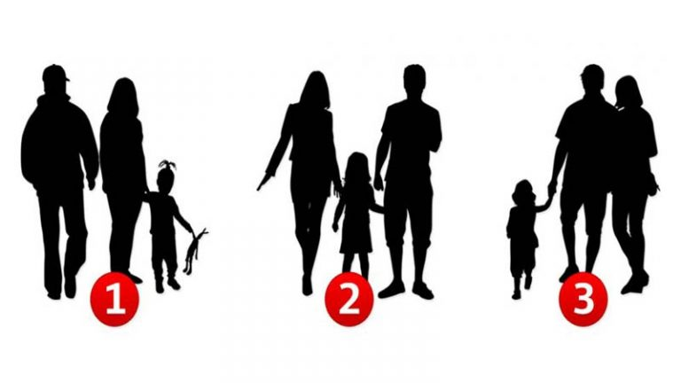
Think critically
Questions:
Are they facing towards us?
Which one of the men is the most caring?
Which one of the women is the most caring?
Which one of these is the happiest family?
Source: www.themindsjournal.com

Slide 11
Critical Thinking
Reasonable and reflective thinking focused on
‘what to believe or what to do’.
(Ennis, 1992)
Intellectually disciplined process…
An ability to analyze the existing facts, make inferences based on assumptions, and evaluate and solve problems.
(Scriven and Paul, 1987)

Slide 12
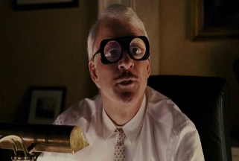
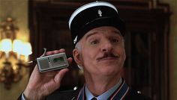
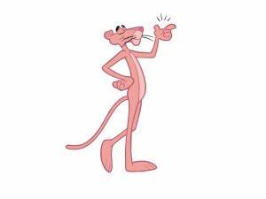
Much older, a concept
In India
கண்ணால் காண்பதும் பொய்,
காதால் கேட்பதும் பொய்,
தீர விசாரிப்பதே மெய்.
What you see can be fake,
What you hear may also be fake,
Only making exhaustive enquiry can get you (close) to the truth.

Slide 13
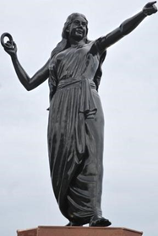
Critical Thinking in India
“Cilappatikaaram” by Ilango
(The Tale of the Anklet)
Kannagi - The Epitome

Slide 14
That’s all for today
எப்பொருள் யார்யார்வாய்க் கேட்பினும் அப்பொருள் மெய்ப்பொருள் காண்ப தறிவு. (Thirukkural)
To discern the truth in every thing is wisdom.
…to be continued

